Slide 1
Improvements of the Pontifical University Website
Created by Jared McVey, Ooluwaseun Oogunsanya, and Bryant Mcgee
Notes:
https://www.worldialogue.org/

Slide 2
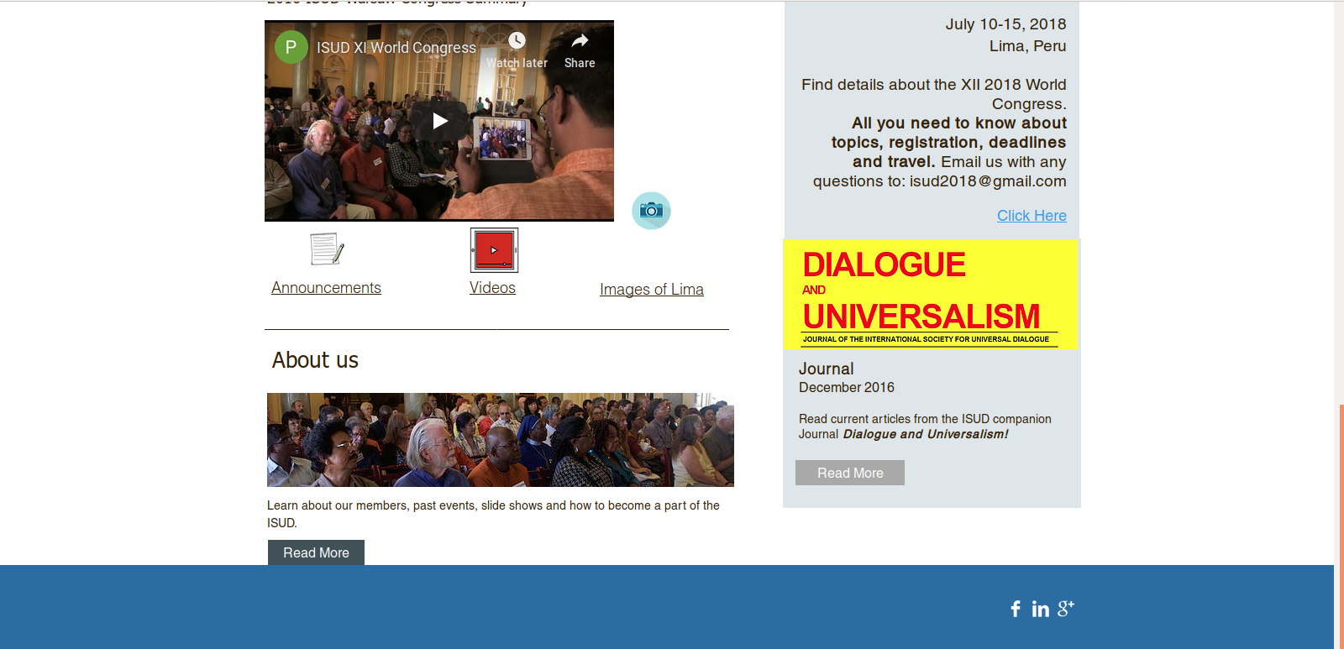

Slide 3
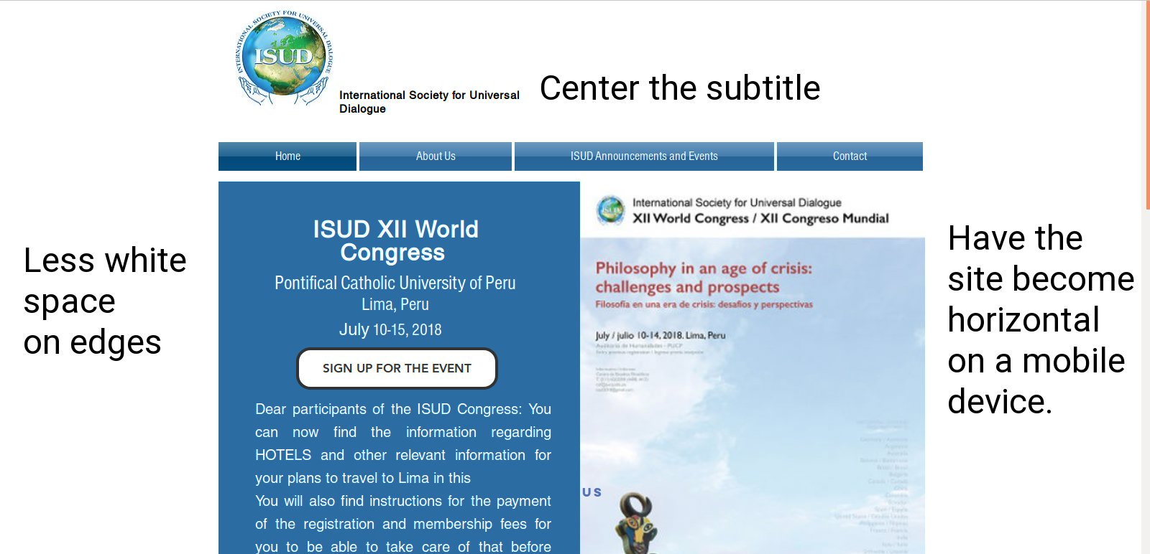

Slide 4
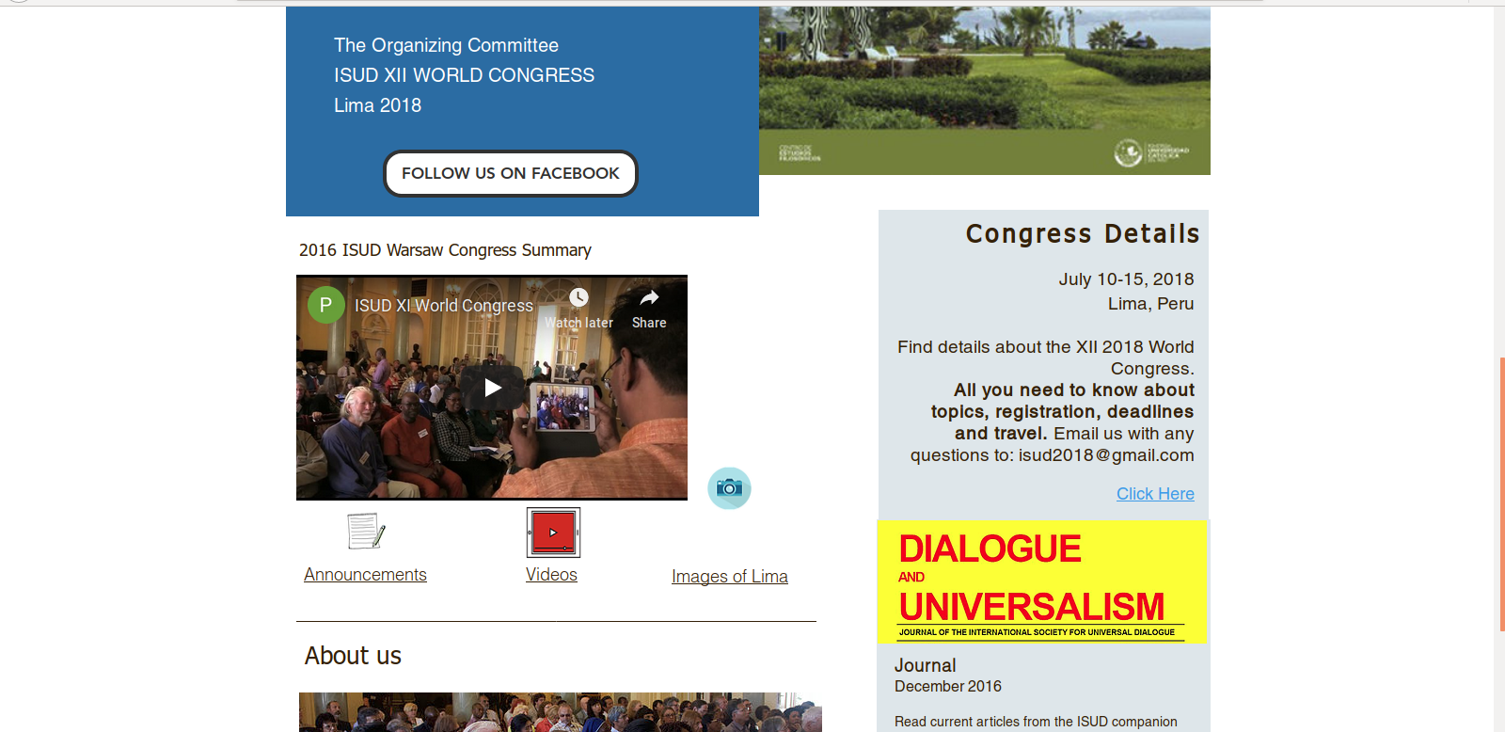

Slide 5
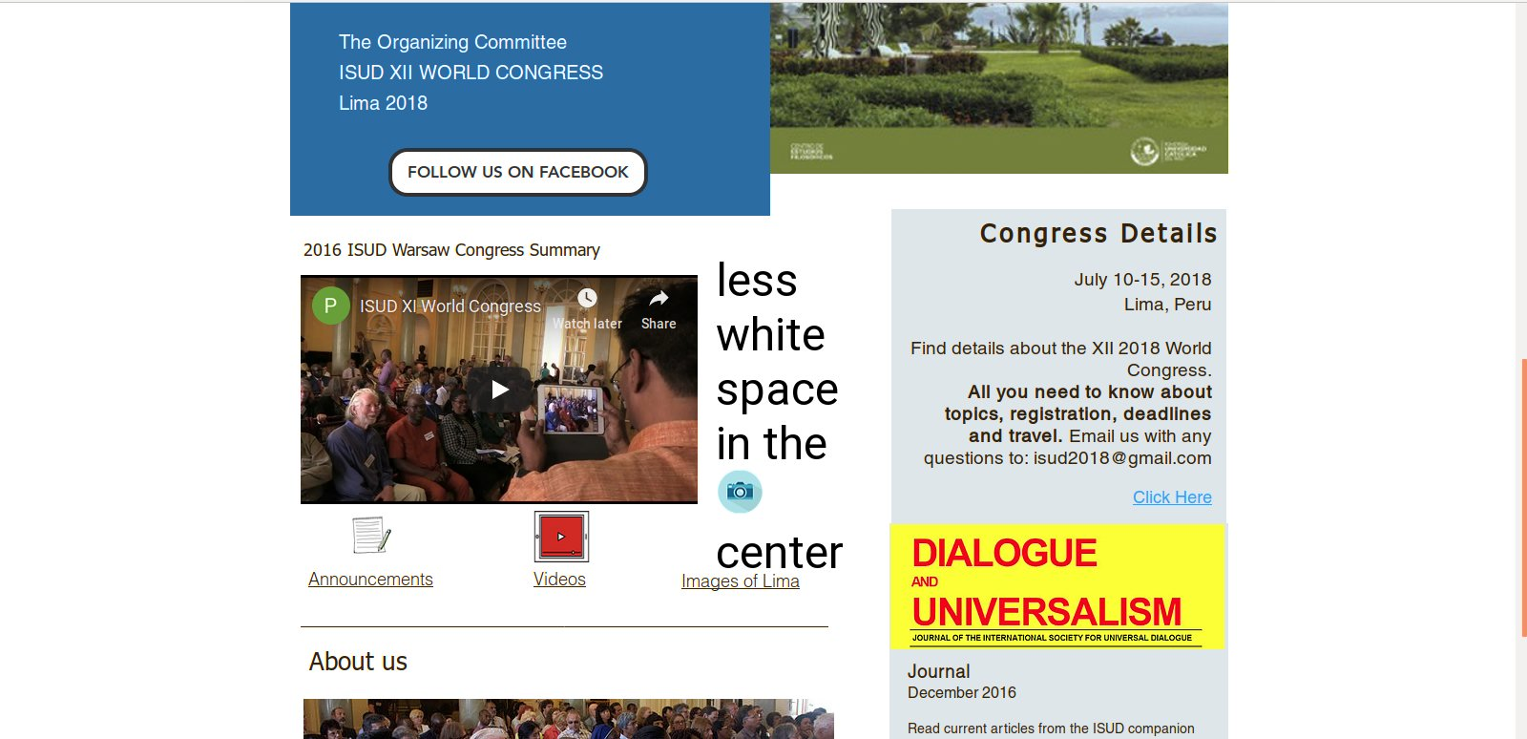

Slide 6
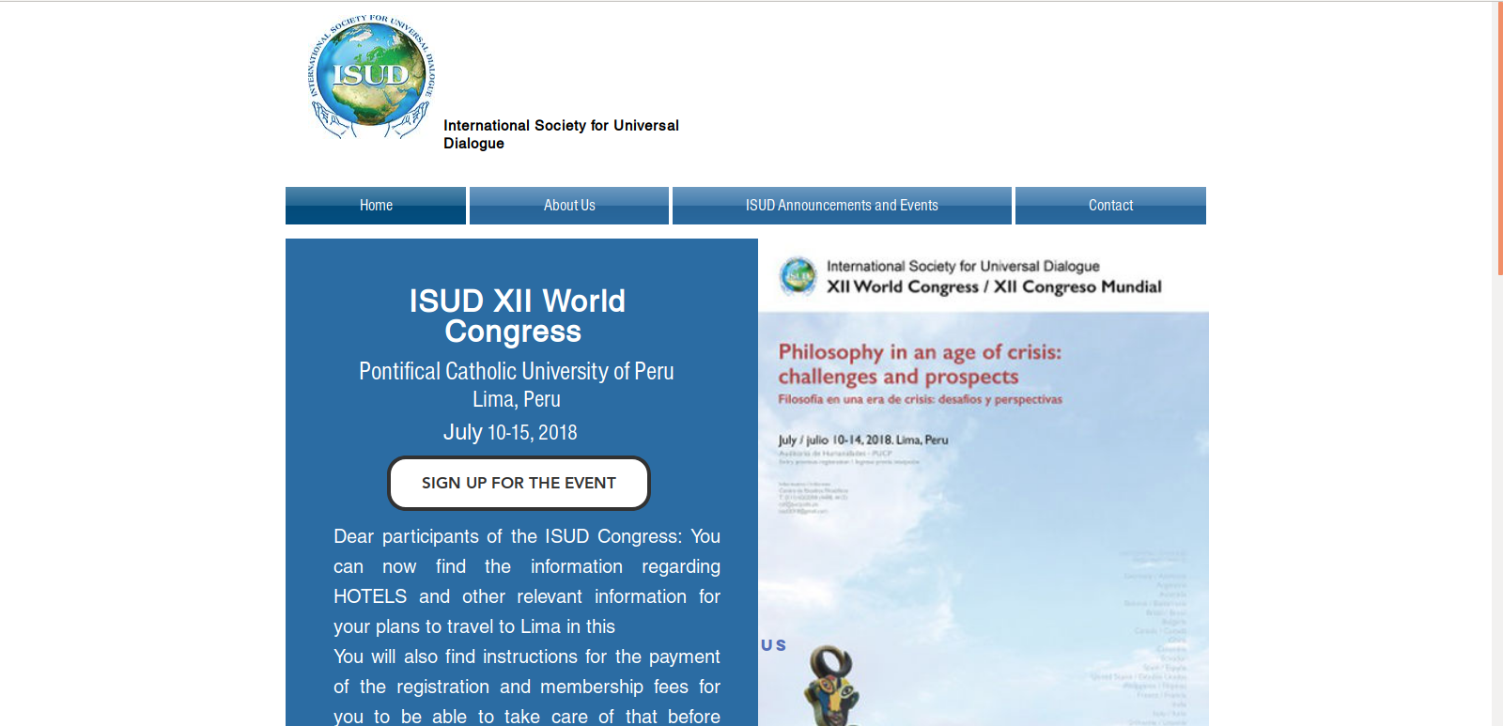

Slide 7
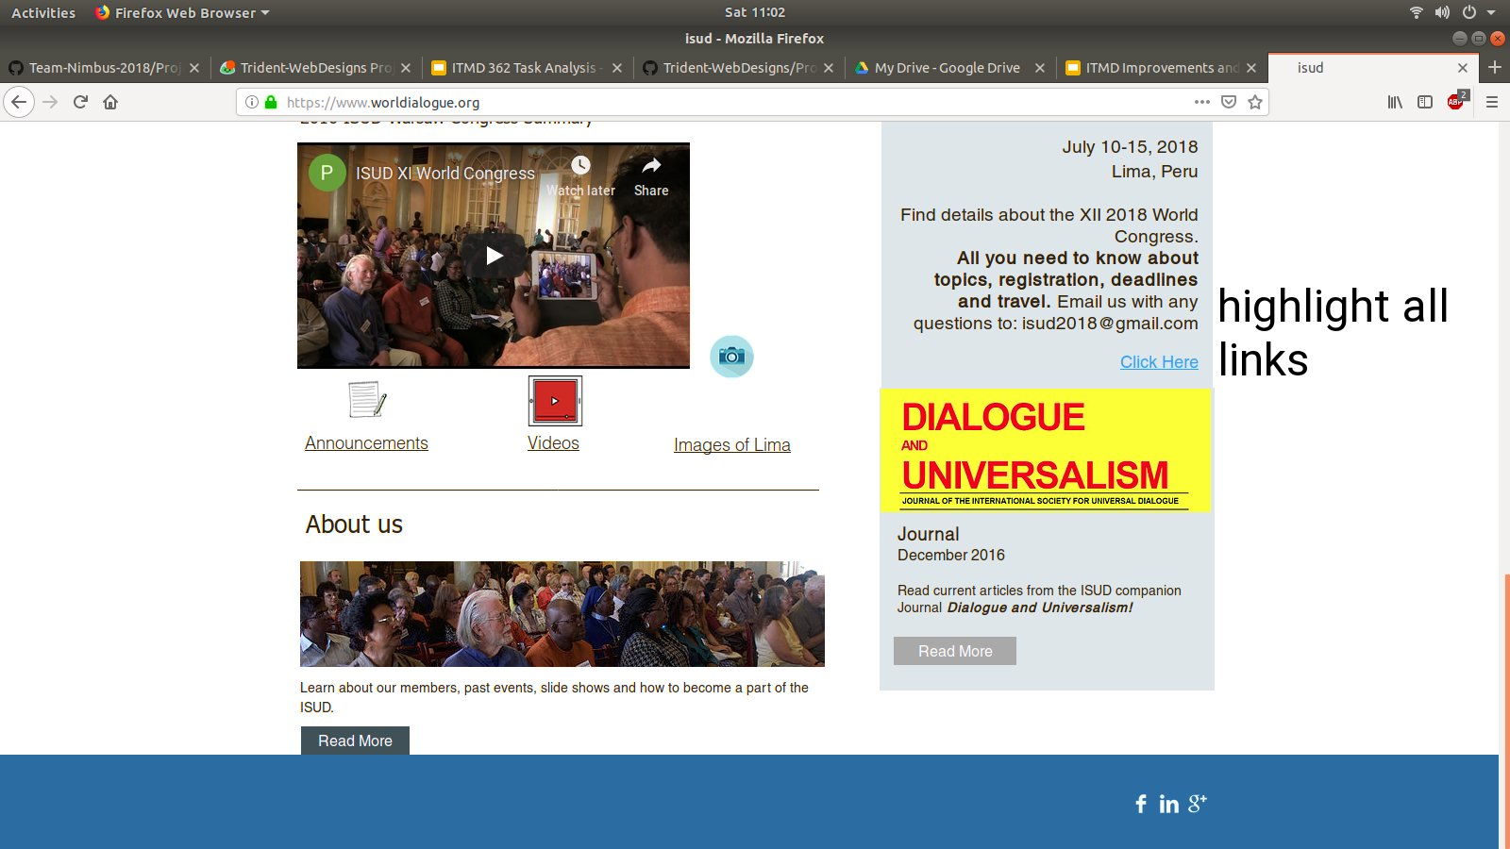

Slide 8
Fonts to use
New Font Stack: Georgia, Trebuchet, sans-serif

Slide 9
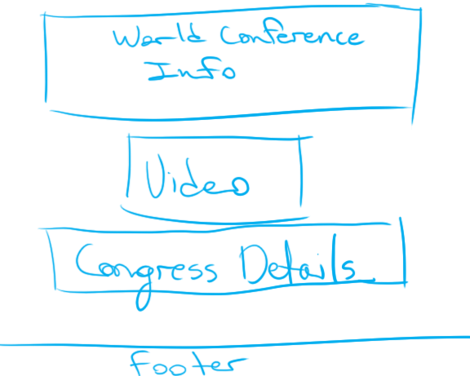

Slide 10
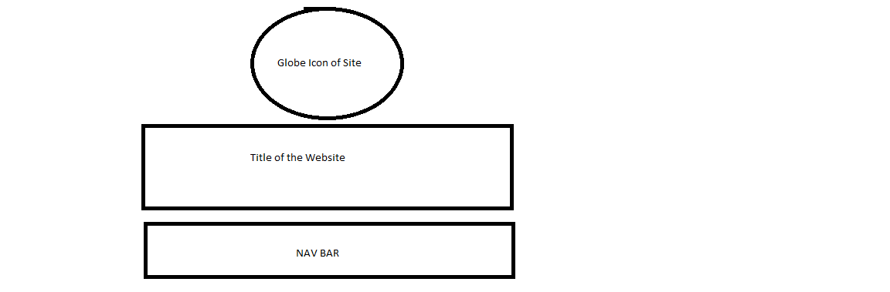

Slide 11
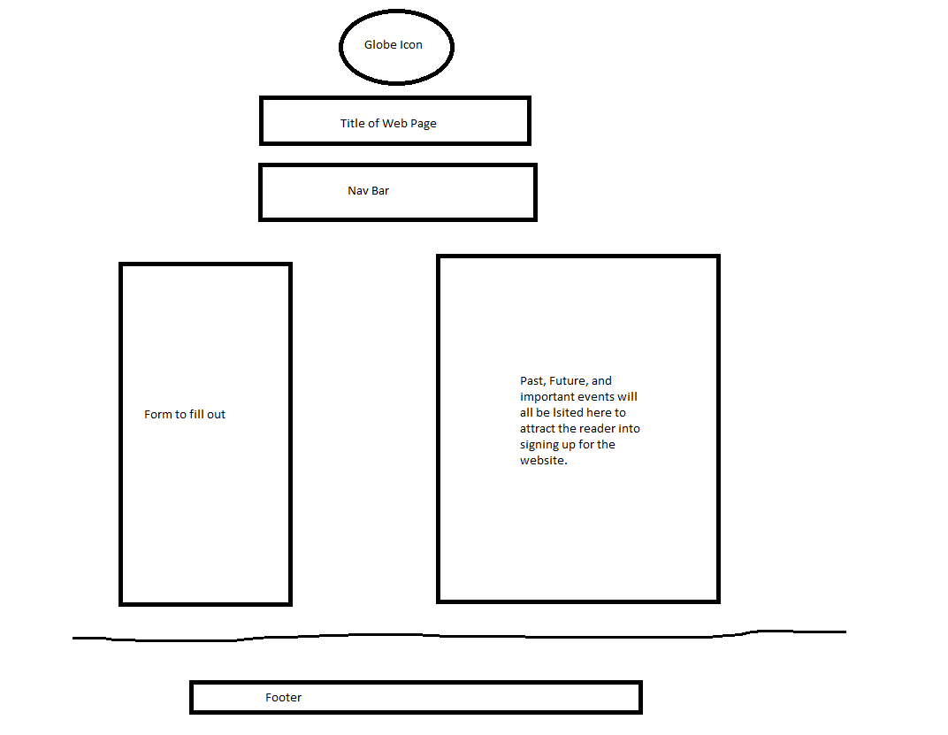

Slide 12
Color Palette
An adjacent color palette for introducing a new console gaming platform
M1: The black and purple work really well together and the darker colors make night time viewing easier on the eyes.
M2: A triadic color palette good for communications
M3: I think the dull more pastel colors would be nice for a university website. Formal, but welcoming

